Slide 1

CZ2007 Introduction to Databases
Querying Relational Databases using SQL
Part-1
Arijit Khan
Assistant Professor
School of Computer Science and Engineering
Nanyang Technological University, Singapore
arijit.khan@ntu.edu.sg

Slide 2
Schedule after Recess Week
8 Lectures
- Week 8 (Oct 07-Oct 11)
- Week 9 (Oct 14-Oct 18)
- Week 10 (Oct 21-Oct 25)
- Week 11 (Oct 28-Nov 01)
SQL
Semi-Structured Data, Quiz-2
2 Lectures
- Week 12 (Nov 02-Nov 08)
- Quiz during Tutorial session
- Quiz syllabus: everything on SQL (Week 8, 9, 10 11)
Summary
- Week 13 (Nov 11-Nov 15)

Slide 3



Why Should You Study Databases?
Make more $$$:
Startups need DB talent right away
Massive industry…
Intellectual (Research):
Science: data poor to data rich
No idea how to handle the data!
Fundamental ideas to/from all of CS:
Systems, theory, AI, logic, stats, analysis….
Many great computer systems ideas started in DB.
arijit.khan@ntu.edu.sg
2/47

Slide 4


About Me …
Instructor (me): Arijit Khan (http://www.ntu.edu.sg/home/arijit.khan/ )
Faculty (Assistant Professor), School of Computer Science and Engineering, NTU Singapore
Research:
- Graph data querying, mining, and systems
- Big-Data management and analytics
- Machine learning
- Uncertain and probabilistic data
- Dynamic and stream data
- Crowdsourcing
Office: N4-02C-94
[Appointment by email: arijit.khan@ntu.edu.sg ]
University of California, Santa Barbara (UCSB)
PhD (2008-2013)
IBM TJ Watson, NY
Intern, 2010
Yahoo! Labs, Barcelona
Intern, 2010
ETH Zurich, Switzerland
Post-doc (2014-2015)
NTU, Singapore
Assistant Professor
(2016-now)

Slide 5
Ask Questions!
The important thing is not to
stop questioning.
Albert Einstein
arijit.khan@ntu.edu.sg
4/47

Slide 6

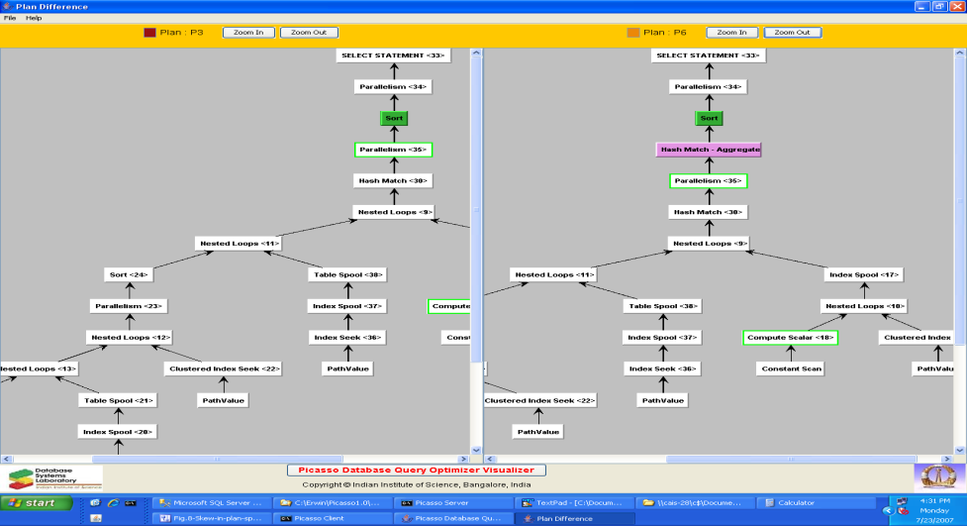
Querying RDBMS (Relational Database Management System)
Relational Algebra
SQL
DBMS Interface
Database
arijit.khan@ntu.edu.sg
5/47

Slide 7

What is SQL?
Structured Query Language (SQL) – standard query language for relational databases. Pronounced “S-Q-L” or “sequel”
A brief history:
– First proposal of SEQUEL (IBM Research, System R, 1974)
– First implementation in SQL/DS (IBM) and Oracle (1981)
– Around 1983 there is a “de facto standard”
– Became official standard in 1986 – defined by the American National Standards Institute (ANSI), and in 1987 – by the International Organization for Standardization (ISO)
– ANSI SQL89
– ANSI SQL92 (SQL2)
– ANSI SQL99 (SQL3)
– ANSI SQL 2003 (added OLAP, XML, etc.)
– ANSI SQL 2006 (added more XML)
– … …. …
– ANSI SQL 2016 (added pattern matching, JSON, etc.)
6/47

Slide 8
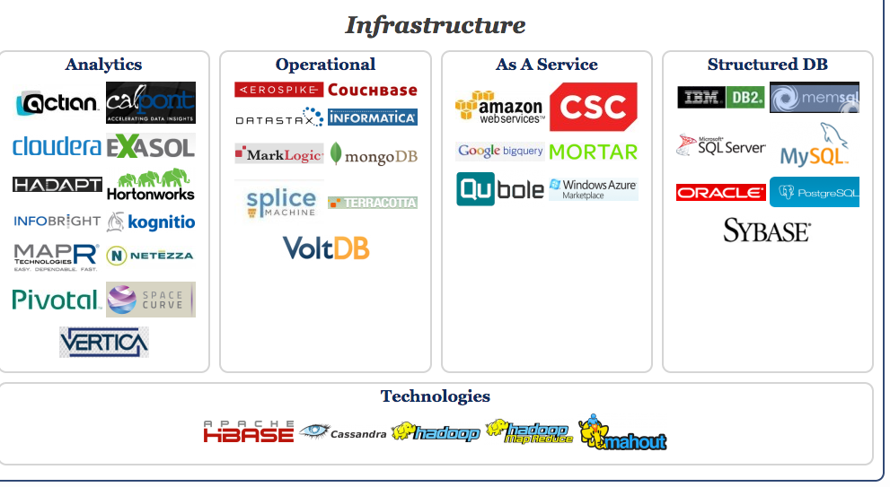
Present Days: Big Data
New technology. Same SQL Principles
7/47

Slide 9
What SQL we shall study?
All major database vendors (Oracle, IBM, Microsoft, Sybase) conform to SQL standard
Although database companies have added “proprietary” extensions (different dialects)
Commercial systems offer features that are not part of the standard
– Incompatibilities between systems
– Incompatibilities with newer standards (e.g. triggers in SQL:1999)
– We concentrate more on the principles
– (mostly) We will study SQL92 - a basic subset
arijit.khan@ntu.edu.sg
8/47

Slide 10

Best Practice (as we learn SQL)
- Run your query in the Lab (they usually provide MySQL?)
- (It may not compile, but might still be correct!)
Always check in Google
Consult with the Book and course material
- Database Systems: The Complete Book; Hector Garcia-Molina Jeffrey D. Ullman, Jennifer Widom
- (Book available online)
9/47

Slide 11
Best Practice (as we learn SQL)
- Run your query in the Lab (they usually provide MySQL?)
- (It may not compile, but might still be correct!)
Always check in Google
Consult with the Book and course material
- Database Systems: The Complete Book; Hector Garcia-Molina Jeffrey D. Ullman, Jennifer Widom
- (Book available online)
Other sources:
1. Database System Concepts – book by Avi Silberschatz, Henry F. Korth, and S. Sudarshan
2. CMU database group course lecture videos in Youtube – by Andy Pavlo (https://www.youtube.com/channel/UCHnBsf2rH-K7pn09rb3qvkA)
3. Comparison of different SQL implementations – by Troels Arvin (http://troels.arvin.dk/db/rdbms/)

Slide 12
What we want to do with SQL?
Today’s lecture: Chapter 6.1 of the Book “Database Systems: The Complete Book; Hector Garcia-Molina Jeffrey D. Ullman, Jennifer Widom
Manage and query the database (a set of relations / tables)
What we want to do on the relations?
Retrieve Insert Delete Update
arijit.khan@ntu.edu.sg
10/47

Slide 13

More about SQL
Declarative Language
SQL is a declarative language (non-procedural).
A SQL query specifies what to retrieve but not how to retrieve it.
What is a procedural language ??
arijit.khan@ntu.edu.sg
11/47

Slide 14
More about SQL
Declarative Language
SQL is a declarative language (non-procedural).
A SQL query specifies what to retrieve but not how to retrieve it.
What is a procedural language ??
Procedure/ Functions – Imperative Languages
Write instructions on how to do it
C, C++, Java
arijit.khan@ntu.edu.sg
12/47

Slide 15
More about SQL
Declarative Language
SQL is a declarative language (non-procedural).
A SQL query specifies what to retrieve but not how to retrieve it.
What is a procedural language ??
Procedure/ Functions – Imperative Languages
Write instructions on how to do it
C, C++, Java
SQL is Not a complete programming language
It does not have control or iteration commands.

Slide 16

Stuffs supported by SQL
Data Manipulation Language (DML)
Perform queries
Perform updates (add/ delete/ modify)
Data Definition Language (DDL)
Embedded SQL
We shall not study this !
arijit.khan@ntu.edu.sg
14/47

Slide 17
Stuffs supported by SQL
Data Manipulation Language (DML)
Perform queries
Perform updates (add/ delete/ modify)
Data Definition Language (DDL)
Creates databases, tables, indices
Create views
Specify authorization
Specify integrity constraints
Embedded SQL
We shall not study this !
arijit.khan@ntu.edu.sg
15/47

Slide 18
Stuffs supported by SQL
Data Manipulation Language (DML)
Perform queries
Perform updates (add/ delete/ modify)
Data Definition Language (DDL)
Creates databases, tables, indices
Create views
Specify authorization
Specify integrity constraints
Embedded SQL
Wrap a high-level programming language around DML to do more sophisticated queries/updates
We shall not study this !
arijit.khan@ntu.edu.sg
16/47

Slide 19


Roadmap (SQL)
Today’s lecture: Chapter 6.1 of the Book “Database Systems: The Complete Book; Hector Garcia-Molina Jeffrey D. Ullman, Jennifer Widom
Introduction to SQL
Querying single relation
Study-at-Home slides at the end of every lecture
They will be in the syllabus of Quiz-2 and Final Exam
More examples
Study them at home, will be discussed at the beginning of next lecture
If any questions, ask me !!
arijit.khan@ntu.edu.sg
17/47

Slide 20
Roadmap (SQL)
Introduction to SQL
Lecture-1
Querying single relation
Ordering Tuples
Multi-relation queries
Lecture-2
Subqueries
Set operations
Bag semantics
Join expressions
Aggregation
Lectures-3 & 4
arijit.khan@ntu.edu.sg
18/47

Slide 21

Recap: Roadmap (SQL)
Groupings
Creation of tables
Database modifications
Constraints
Views
Lecture-5 & 6
Triggers
Indexes
Lecture-7 & 8
That would be all about Quiz-2!!
arijit.khan@ntu.edu.sg

Slide 22

Questions?
arijit.khan@ntu.edu.sg
20/47

Slide 23
Tables in SQL
A relation or table is a multiset of tuples having the attributes specified by the schema
Product
A multiset is an unordered list (or: a set with multiple duplicate instances allowed)
PName | Price | Manufacturer
Gizmo | 19.99 | GizmoWorks
Powergizmo | 29.99 | GizmoWorks
SingleTouch | 149.99 | Canon
MultiTouch | 203.99 | Hitachi
List: [1, 1, 2, 3]
Set: {1, 2, 3}
Multiset: {1, 1, 2, 3}
i.e. no next(), etc. methods!
arijit.khan@ntu.edu.sg
21/47

Slide 24
Attributes (Columns) in a Table
Product
An attribute (or column) is a typed data entry present in each tuple in the relation
PName | Price | Manufacturer
Gizmo | 19.99 | GizmoWorks
Powergizmo | 29.99 | GizmoWorks
SingleTouch | 149.99 | Canon
MultiTouch | 203.99 | Hitachi
Attributes must have an atomic type in standard SQL, i.e. not a list, set, etc.
arijit.khan@ntu.edu.sg
22/47

Slide 25
Tuples (Rows) in a Table
Product
PName | Price | Manufacturer
Gizmo | 19.99 | GizmoWorks
Powergizmo | 29.99 | GizmoWorks
SingleTouch | 149.99 | Canon
MultiTouch | 203.99 | Hitachi
A tuple or row is a single entry in the table having the attributes specified by the schema
Also referred to sometimes as a record
arijit.khan@ntu.edu.sg
23/47

Slide 26
More on Tables
Product
PName | Price | Manufacturer
Gizmo | 19.99 | GizmoWorks
Powergizmo | 29.99 | GizmoWorks
SingleTouch | 149.99 | Canon
MultiTouch | 203.99 | Hitachi
The number of tuples is the cardinality of the relation
The number of attributes is the arity of the relation
arijit.khan@ntu.edu.sg
24/47

Slide 27
Data Types in SQL
Atomic types:
Characters: CHAR(20), VARCHAR(50)
Numbers: INT, BIGINT, SMALLINT, FLOAT
Others: MONEY, DATETIME, …
Every attribute must have an atomic type
Hence tables are flat
Product
PName | Price | Manufacturer
Gizmo | 19.99 | GizmoWorks
Powergizmo | 29.99 | GizmoWorks
SingleTouch | 149.99 | Canon
MultiTouch | 203.99 | Hitachi
arijit.khan@ntu.edu.sg
25/47

Slide 28
Schema of a Table
Product
PName | Price | Manufacturer
Gizmo | 19.99 | GizmoWorks
Powergizmo | 29.99 | GizmoWorks
SingleTouch | 149.99 | Canon
MultiTouch | 203.99 | Hitachi
The schema of a table is the table name, its attributes, and their types:
A key is an attribute whose values are unique; we underline a primary key
Product(Pname: string, Price: float, Manufacturer: string)
Product(Pname: string, Price: float, Manufacturer: string)
arijit.khan@ntu.edu.sg
26/47

Slide 29
Principle Form of SQL
Basic Structure of SQL
SELECT desired attributes (A1, A2, … , An)
FROM one or more tables (R1, R2, … , Rm)
WHERE condition about tuples of the tables (P)
Mapping to Relational Algebra
Π _{A1, A2, …, An} (σ_{P} (R1 × R2 × … × Rm))
arijit.khan@ntu.edu.sg
27/47

Slide 30
Principle Form of SQL
Basic Structure of SQL
SELECT desired attributes (A1, A2, … , An)
FROM one or more tables (R1, R2, … , Rm)
WHERE condition about tuples of the tables (P)
Today, we talk about “One Table” only ☺
Mapping to Relational Algebra
Π _{A1, A2, …, An} (σ_{P} (R1 × R2 × … × Rm))
Today, we talk about “One Relation” only ☺
arijit.khan@ntu.edu.sg
28/47

Slide 31
SQL Syntax
Reserved words / Keywords
There is a set of reserved words that cannot be used as names for database objects.
SELECT, FROM, WHERE, etc.
Case-insensitive
SQL is generally case-insensitive.
Exception: is string constants. 'FRED' not the same as 'fred'.
Use single quotes for constants:
‘abc’ – Okay
“abc” – Not okay
White-space ignored
White-space is ignored
All statements end with a semicolon (;)
arijit.khan@ntu.edu.sg
29/47

Slide 32
Simple SQL Query: Selection
Product
Selection is the operation of filtering a relation’s tuples on some condition
PName | Price | Category | Manufacturer
Gizmo | 19.99 | Gadgets | GizmoWorks
Powergizmo | 29.99 | Gadgets | GizmoWorks
SingleTouch | 149.99 | Photography | Canon
MultiTouch | 203.99 | Household | Hitachi
SELECT * FROM Product WHERE Category = ‘Gadgets’
PName | Price | Category | Manufacturer
Gizmo | 19.99 | Gadgets | GizmoWorks
Powergizmo | 29.99 | Gadgets | GizmoWorks
arijit.khan@ntu.edu.sg
30/47

Slide 33
Simple SQL Query: Projection
Product
Projection is the operation of producing an output table with tuples that have a subset of their prior attributes
PName | Price | Category | Manufacturer
Gizmo | 19.99 | Gadgets | GizmoWorks
Powergizmo | 29.99 | Gadgets | GizmoWorks
SingleTouch | 149.99 | Photography | Canon
MultiTouch | 203.99 | Household | Hitachi
SELECT PName, Price, Manufacturer FROM Product WHERE Category = ‘Gadgets’
PName | Price | Manufacturer
Gizmo | 19.99 | GizmoWorks
Powergizmo | 29.99 | GizmoWorks
arijit.khan@ntu.edu.sg
31/47

Slide 34
Notation for (SELECT-FROM-WHERE) Query
Input schema
Product(PName, Price, Category, Manfacturer)
SELECT PName, Price, Manufacturer FROM Product WHERE Category = ‘Gadgets’
Output schema
Answer(PName, Price, Manfacturer)
arijit.khan@ntu.edu.sg
32/47

Slide 35
DISTINCT: Eliminating Duplicates
Category
Gadgets
Photography
Household
SELECT DISTINCT Category
FROM Product
Versus
Category
Gadgets
Gadgets
Photography
Household
SELECT Category
FROM Product
arijit.khan@ntu.edu.sg
33/47

Slide 36
AS: Renaming Attributes
Product
PName | Price | Category | Manufacturer
Gizmo | 19.99 | Gadgets | GizmoWorks
Powergizmo | 29.99 | Gadgets | GizmoWorks
SingleTouch | 149.99 | Photography | Canon
MultiTouch | 203.99 | Household | Hitachi
SELECT PName AS Product, Price AS Cost, Manufacturer FROM Product WHERE Category = ‘Gadgets’
Product | Cost | Manufacturer
Gizmo | 19.99 | GizmoWorks
Powergizmo | 29.99 | GizmoWorks
arijit.khan@ntu.edu.sg
34/47

Slide 37
Expressions in SELECT Clause
Product
PName | Price | Category | Manufacturer
Gizmo | 19.99 | Gadgets | GizmoWorks
Powergizmo | 29.99 | Gadgets | GizmoWorks
SingleTouch | 149.99 | Photography | Canon
MultiTouch | 203.99 | Household | Hitachi
SELECT PName, Price*1.4 AS Cost_IN_SGD, Manufacturer FROM Product WHERE Category = ‘Gadgets’
PName | Cost_IN_SGD | Manufacturer
Gizmo | 27.99 | GizmoWorks
Powergizmo | 41.99 | GizmoWorks
arijit.khan@ntu.edu.sg
35/47

Slide 38
Questions?
arijit.khan@ntu.edu.sg
36/47

Slide 39
Summary
Introduction to SQL
Querying single relation
Study-at-Home
More examples and cases for “Querying Single Relation” (Slides 38-47)
Complex conditions in WHERE clause
NULL values and 3-valued logic
Will be in the syllabus of Quiz-2 and Final Exam
arijit.khan@ntu.edu.sg
37/47

Slide 40
Complex Conditions in WHERE Clause: AND
Product
PName | Price | Category | Manufacturer
Gizmo | 19.99 | Gadgets | GizmoWorks
Powergizmo | 29.99 | Gadgets | GizmoWorks
SingleTouch | 149.99 | Photography | Canon
MultiTouch | 203.99 | Household | Hitachi
SELECT PName, Price, Manufacturer FROM Product WHERE Category = ‘Gadgets’ AND Price < 20
PName | Price | Manufacturer
Gizmo | 19.99 | GizmoWorks
arijit.khan@ntu.edu.sg
38/47

Slide 41
Complex Conditions in WHERE Clause: BETWEEN
Product
PName | Price | Category | Manufacturer
Gizmo | 19.99 | Gadgets | GizmoWorks
Powergizmo | 29.99 | Gadgets | GizmoWorks
SingleTouch | 149.99 | Photography | Canon
MultiTouch | 203.99 | Household | Hitachi
SELECT PName, Price, Manufacturer FROM Product WHERE Price BETWEEN 10 AND 20
PName | Price | Manufacturer
Gizmo | 19.99 | GizmoWorks
arijit.khan@ntu.edu.sg
39/47

Slide 42
Complex Conditions in WHERE Clause: IN
Product
PName | Price | Category | Manufacturer
Gizmo | 19.99 | Gadgets | GizmoWorks
Powergizmo | 29.99 | Gadgets | GizmoWorks
SingleTouch | 149.99 | Photography | Canon
MultiTouch | 203.99 | Household | Hitachi
SELECT PName, Price, Manufacturer FROM Product WHERE Manufacturer IN (‘GizmoWorks’, ‘Samsung’, ‘Hitachi’)
PName | Price | Manufacturer
Gizmo | 19.99 | GizmoWorks
Powergizmo | 29.99 | GizmoWorks
MultiTouch | 203.99 | Hitachi
arijit.khan@ntu.edu.sg
40/47

Slide 43
Complex Conditions in WHERE Clause: LIKE (String Pattern Matching)
s LIKE p: pattern
matching on strings
Patterns are case sensitive
p may contain two special symbols:
% = any sequence of Characters
_ = any single character
Product
PName | Price | Category | Manufacturer
Gizmo | 19.99 | Gadgets | GizmoWorks
Powergizmo | 29.99 | Gadgets | GizmoWorks
SingleTouch | 149.99 | Photography | Canon
MultiTouch | 203.99 | Household | Hitachi
PName | Price | Category | Manufacturer
Powergizmo | 29.99 | Gadgets | GizmoWorks
SELECT * FROM Products WHERE PName LIKE ‘%gizmo%’
arijit.khan@ntu.edu.sg

Slide 44
Complex Conditions in WHERE Clause: LIKE (String Pattern Matching)
s LIKE p: pattern
matching on strings
Patterns are case sensitive
p may contain two special symbols:
% = any sequence of Characters
_ = any single character
More Examples
‘John%’ – Matches any string beginning with “John”
‘%ohn%’ – Matches any string containing “ohn” as substring
‘_ _ _’ – Matches any string of exactly three characters
‘_ _ _%’ – Matches any string of at least three characters
‘ab\%cd%’ – Match all strings beginning with “ab%cd”
arijit.khan@ntu.edu.sg
42/47

Slide 45
NULL Values
Product
PName | Price | Category | Manufacturer
Gizmo | 19.99 | Gadgets | GizmoWorks
Powergizmo | 29.99 | Gadgets | GizmoWorks
SingleTouch | 149.99 | Photography | Canon
iPhone 8 | NULL | Smartphone | Apple
NULL
Tuples in SQL relations can have NULL as a value for one or more attributes.
Meaning
Missing value : e.g., we know ‘iPhone 8’ has some Price, but we don’t know what it is.
Inapplicable : e.g., ‘iPhone 8’ is not available yet in the market

Slide 46
NULL Values
Product
PName | Price | Category | Manufacturer
Gizmo | 19.99 | Gadgets | GizmoWorks
Powergizmo | 29.99 | Gadgets | GizmoWorks
SingleTouch | 149.99 | Photography | Canon
iPhone 8 | NULL | Smartphone | Apple
SELECT PName, Price, Manufacturer FROM Product WHERE Price <= 150 OR Price >= 150
Include or not include NULL values?
Answer in the remaining slides ☺
arijit.khan@ntu.edu.sg
44/47

Slide 47
SQL: 3-Valued Logic
3-value logic
The logic of conditions in SQL is really 3-valued logic
TRUE, FALSE, UNKNOWN.
Comparing with NULL
SQL Rules
When any value is compared with NULL, the truth value is UNKNOWN.
A query only produces a tuple in the answer if its truth value for the WHERE clause is TRUE (not FALSE or UNKNOWN).
arijit.khan@ntu.edu.sg
45/47

Slide 48
3-Valued Logic
3-Value Logic
AND, OR, NOT
To understand how AND, OR, and NOT work in 3-valued logic, think of TRUE = 1, FALSE = 0, and UNKNOWN = ½
AND = MIN
OR = MAX
NOT(x) = 1-x
UNKNOWN
SELECT PName, Price, Manufacturer FROM Product WHERE Price <= 150 OR Price >= 150
NULL price values will NOT be reported
UNKNOWN
UNKNOWN
arijit.khan@ntu.edu.sg
46/47

Slide 49

arijit.khan@ntu.edu.sg
47/47

